Slide 1
SUS Language

Slide 2
Motivation

Slide 3
SUS
Target
Verilog
VHDL
Target
Synchronous
Logics
FlipFlop
Based
(FPGA)
Physical
Hardware
(incl. async)
(ASICs)
Imperative/HLS
Representible

Slide 4
HLS
Advantages
Fast to Develop
CPU Simulation Easy
Shallow-ish Learning Curve
Disadvantages
No 1-to-1 Text to HW mapping
Hardware != Imperative
Many HW not representible
Intel & Xilinx Proprietary Monopoly
Require compiler optimization

Slide 5
Why not HLS?
Hardware != Imperative
Fiddly
Rely on compiler optimization for decent hardware
Why is my pipeline only having 50% throughput?
Cannot express exact timing requirements
Intel & Xilinx proprietary monopolies.

Slide 6
Require Compiler Optimization
Naive HW synthesis would have terrible performance
Fiddle to make the compiler do The Right Thing™
Compiler diagnostics aren’t directly applicable to program text
« How do I make this component synthesize correctly? »
« Why is my clock frequency so slow? »
« Why do I only have 50% HBM throughput? »
« Why am I getting such routing congestion? »

Slide 7
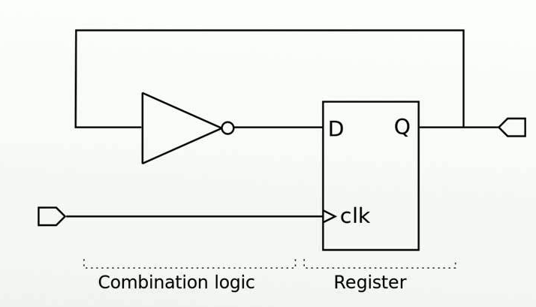
RTL Is No Silver Bullet
Trading HLS for RTL is like dropping from python to assembly.
Sure, you get strong control, but development slows to a snails pace
Many classes of bugs:
FIFO overruns
Timing miscalculations
Stale State
Bad resets
Modifications require extensive changes

Slide 8
RTL SOTA
Verilog/VHDL – Main drivers in enterprise
SystemVerilog – Abstraction, Interfaces, Mostly for sim
TL-Verilog – Easy pipelining notation
Filament – Stateful pipelines
Chisel/Spinal/BlueSpec – Strong metaprogramming

Slide 9
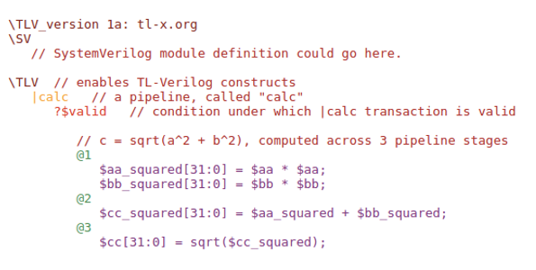
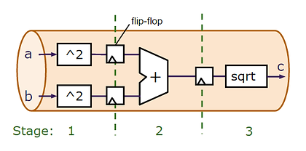
TL-Verilog

Slide 10
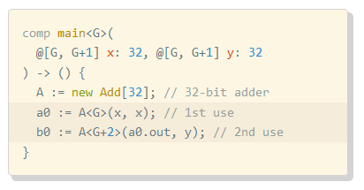
Filament

Slide 11















Software Languages
Hardware Languages
Low
Level
Control
Low
Level
Control
TL-Verilog
Safety
Safety

Slide 12
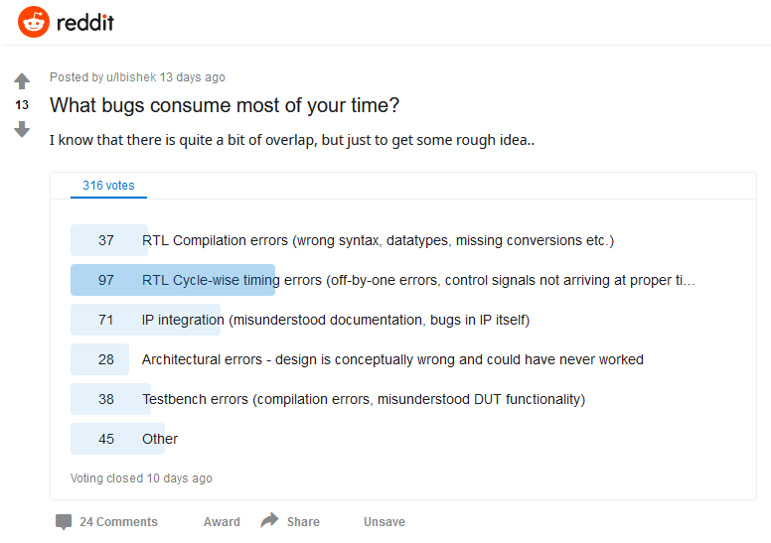

Slide 13
Other sources of bugs
Clock Domain Crossings
Bad Timing Constraints
FIFO Overruns

Slide 14
Goals
Low-Level control
Terseness
Compile-Time Verification
Common modifications should be easy
Full Replacement of Verilog and VHDL in FPGA Space

Slide 15
Non-Goals
Optimization
Custom Synthesis
BSP Replacement
High Clock Speed Guarantees
Turing-Complete hardware generation
ASIC Synthesis

Slide 16
Initial Ideas

Slide 17
Three Levels of State
Transient State (Pipeline Registers)
No reset, no clock enable
Intra-Stream State
No reset, sometimes clock enable
Global State
Reset or initial conditions required. CE Required

Slide 18
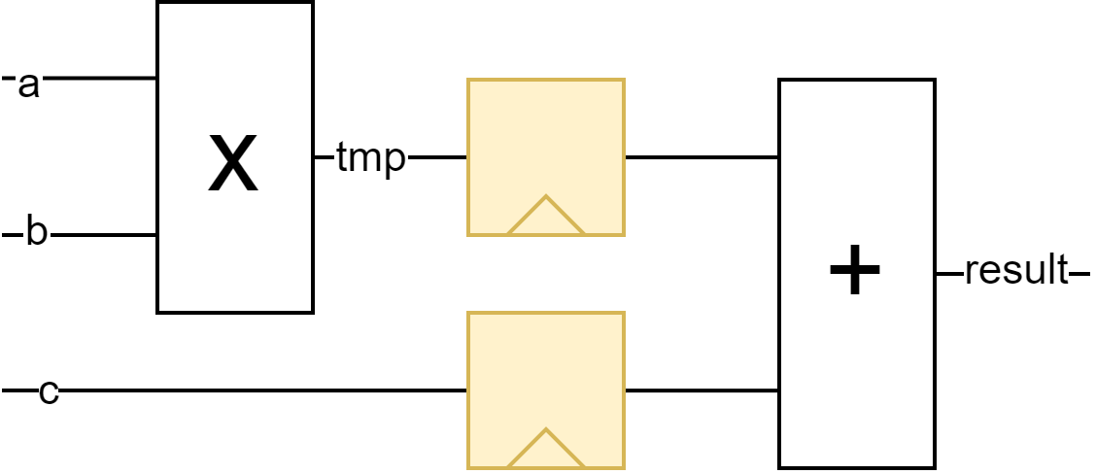
Easy Pipelining
module multiply_add :
int a,
int b,
int c
-> int result
{ reg int tmp = a * b;
result = tmp + c; }
module multiply_add(
input clk,
input[31:0] a,
input[31:0] b,
input[31:0] c,
output[31:0] result_D
) {
reg[31:0] tmp_D;
reg[31:0] c_D;
always @(posedge clk) begin
tmp_D <= a * b;
c_D <= c;
end
assign result_D = tmp_D + c_D;
}

Slide 19
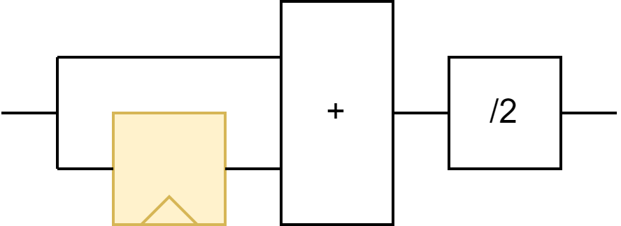
// Explicitly state when valid
timeline (v->/) .. (v->v)*
module blur2 :
int data -> int blurred
{ state int prev = data;
#
loop {
blurred = prev + data / 2; prev = data;
#
} }
Stream Processing
module blur2(
input clk,
input[31:0] data,
output[31:0] blurred
) {
reg[31:0] prev;
always @(posedge clk) begin
prev <= data;
end
assign blurred = prev + data / 2;
// when is blurred valid?
}

Slide 20
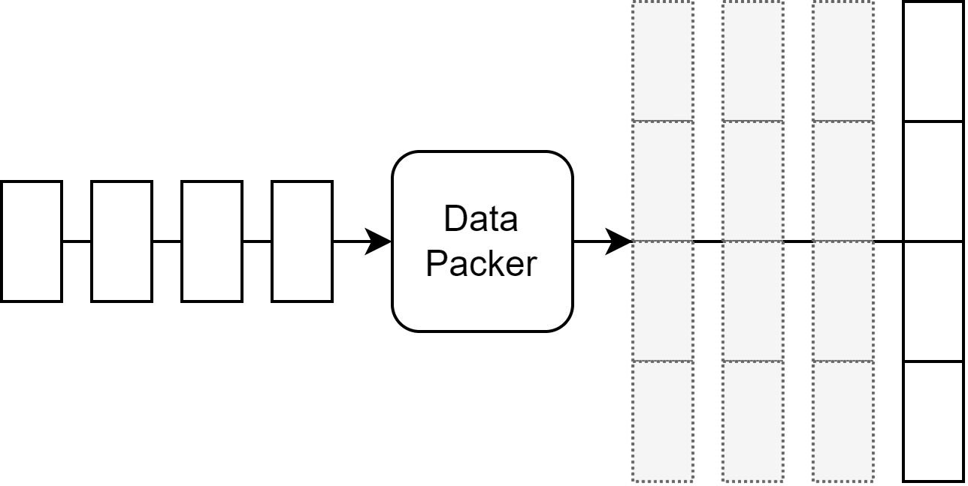
Multi-Cycle Protocols
Some data streams require multiple cycles
Define shape and validities of stream
Can type-check on proper use of this data stream!

Slide 21
Pipe and Time combination
module multiply_aggregate(
input clk,
input start,
input done,
input[31:0] data,
output reg[31:0] sum,
output sumValid
) { always @(posedge clk) begin
if(start) {
sum <= 0;
} else if(done) {
}
prev <= data;
end
assign blurred = prev + data / 2;
}

Slide 22
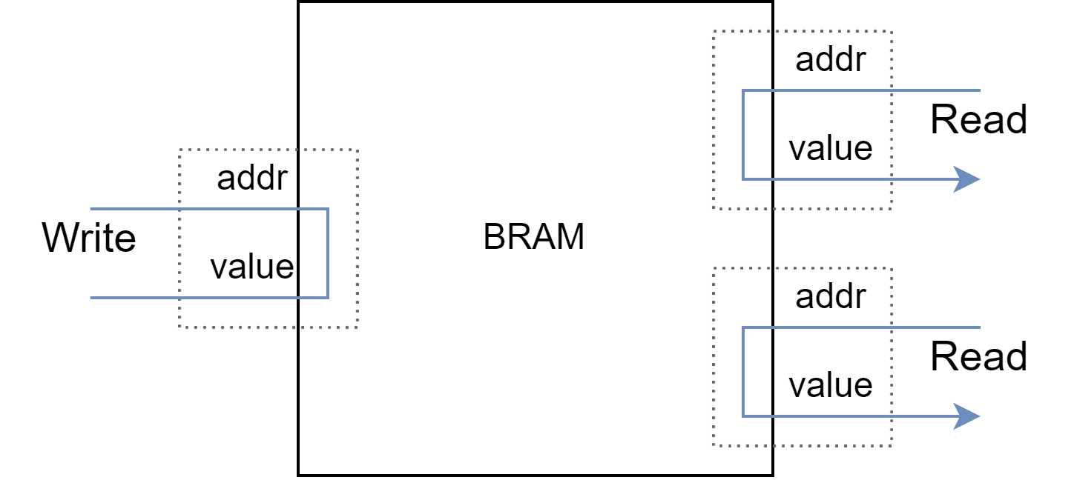
True Stateful modules
FIFOs
Memory
PID Controllers
Blob of State
Interfaces are pipelined

Slide 23
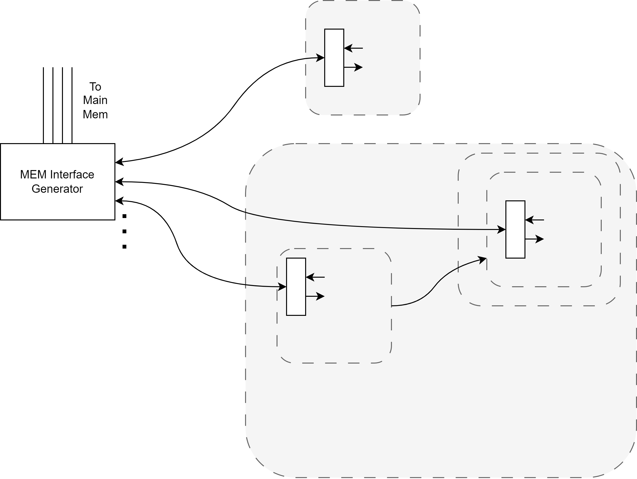
Generators
Dependency Injection
Modules can have generator interface that can be instantiated multiple times.
Module is then actually instantiated with array of all generated instantiations
Main Memory Interface
Multi-Port BRAMs
Externally Injecting ECC Checks

Slide 24
Static Analysis
Integers have bounds
Tracked and checked on every connection
For memory address or packet indexing
Can be inferred most of the time
Boolean information is tracked across if conditions

Slide 25
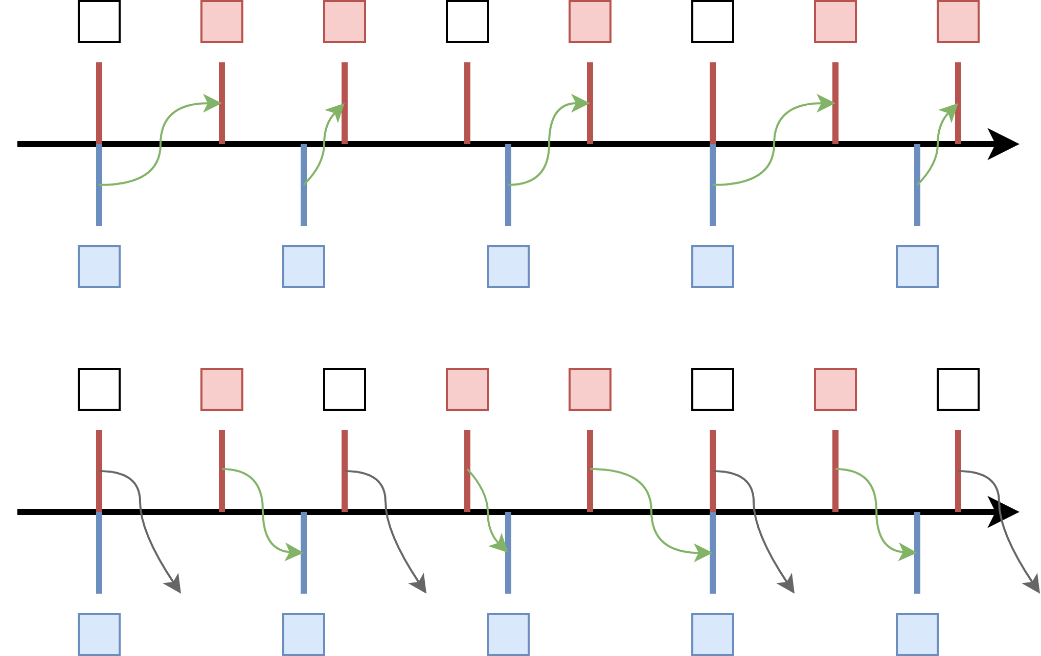
Rhythms for Clock Domain Crossings

Slide 26
Nifty consequences
Automate FIFO sizing
Automate reset generation
Integer min-max sizing instead of bit-widths
Generated hardware can make extensive use of “Don’t care”
Aids in Simulation

Slide 27
Open Questions
Safety for stream ordering?
State Invalidation?
How extensive should protocol specs be?
(Semi-) Constants?
“Compute Phases”?
Generating timing constraints?
Generic vs Concrete conflict
Modules requiring unpredictable input stalls?
Resource saving on long register chains?
Project Scope?
Host to FPGA Comms?

